Slide 1


Slide 2
Hibernate Cache
While working with Hibernate web applications we will face so many problems in its performance due to database traffic.
So some techniques are necessary to maintain its performance.
Hibernate Caching is the best technique to solve this problem.
How we can improve the performance of Hibernate web applications using caching.

Slide 3
Hibernate Cache
The performance of Hibernate web applications is improved using caching by optimizing the database applications.
The cache actually stores the data already loaded from the database, so that the traffic between our application and the database will be reduced when the application want to access that data again.
Maximum the application will works with the data in the cache only.
Whenever some another data is needed, the database will be accessed.
Because the time needed to access the database is more when compared with the time needed to access the cache.
So obviously the access time and traffic will be reduced between the application and the database.
Here the cache stores only the data related to current running application.

Slide 4
Cache Types
First-level cache.
Second-level cache.
Fist level cache in hibernate is enabled by default and you do not need to do anything to get this functionality working.
In fact, you can not disable it even forcefully.
Its easy to understand the first level cache if we understand the fact that it is associated with Session object.

Slide 5
First Level Cache
First level cache is associated with “session” object and other session objects in application can not see it.
The scope of cache objects is of session. Once session is closed, cached objects are gone forever.
First level cache is enabled by default and you can not disable it.
When we query an entity first time, it is retrieved from database and stored in first level cache associated with hibernate session.
If we query same object again with same session object, it will be loaded from cache and no sql query will be executed.
The loaded entity can be removed from session using evict() method. The next loading of this entity will again make a database call if it has been removed using evict() method.
The whole session cache can be removed using clear() method. It will remove all the entities stored in cache.

Slide 6
First Level Cache

Slide 7
First Level Cache
Second level cache is created in session factory scope and is available to be used in all sessions which are created using that particular session factory.
Once session factory is closed, all cache associated with it die and cache manager also closed down.
Further, It also means that if you have two instances of session factory (normally no application does that)

Slide 8
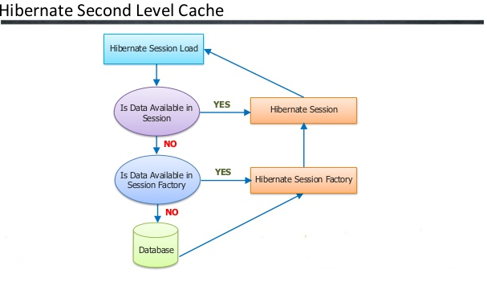
Second Level Cache

Slide 9
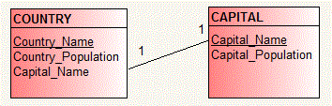
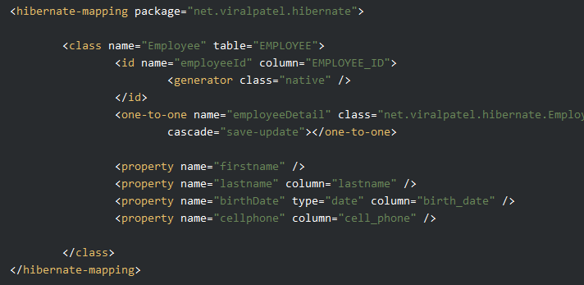
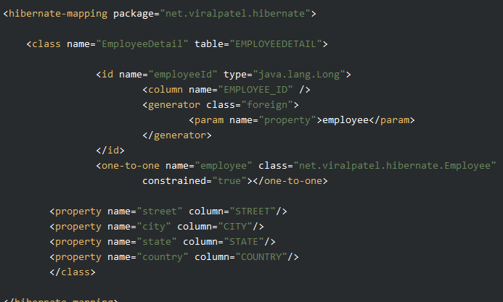
Hibernate Mapping – One To One

Slide 10
Hibertnate Mapping – One To One
@OneToOne
@JoinColumn(name="Capital_Name")
Capital capital;

Slide 11
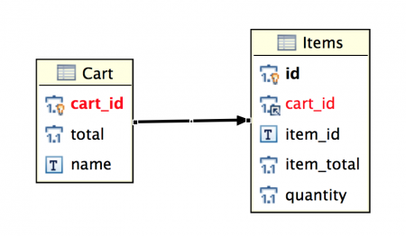
Hibernate Mapping – One To Many
https://www.journaldev.com/2924/hibernate-one-to-many-mapping-annotation

